Slide 1
Bias and Variance Trade off
Name : C. Revanth
Roll No: 21691A3278
Madanapalle Institute of Technology and Science

Slide 2
Content:
Bias
Variance
Bias and Variance Trade off
L1 regularization
L2 regularization
Elastic Net regularization

Slide 3
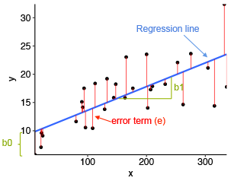
Linear regression
It shows the relationship between the independent variables(x) and dependent variables(y).
The graphical representation of linear regression is as follows
Linear regression formula , y=m x+ b0
The error function , Mean squared error or cost function = 1/n ∑ (y – ȳ) ²
where as n= no.of rows

Slide 4
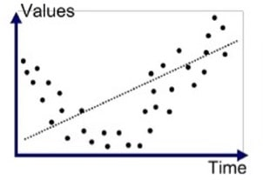
Bias
The inability of machine learning model to truly capture the relationship or a pattern in the training data
For example:
The actual points are in quadratic, but the regression line is in straight line.

Slide 5
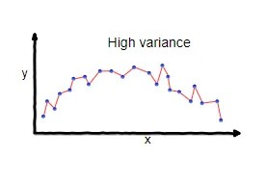
Variance
Variance is some error which we test the dataset.
In simple words, variance occurs when the model is over trained, but it predicts wrongly.
For example:
Difference of fits in different datasets

Slide 6
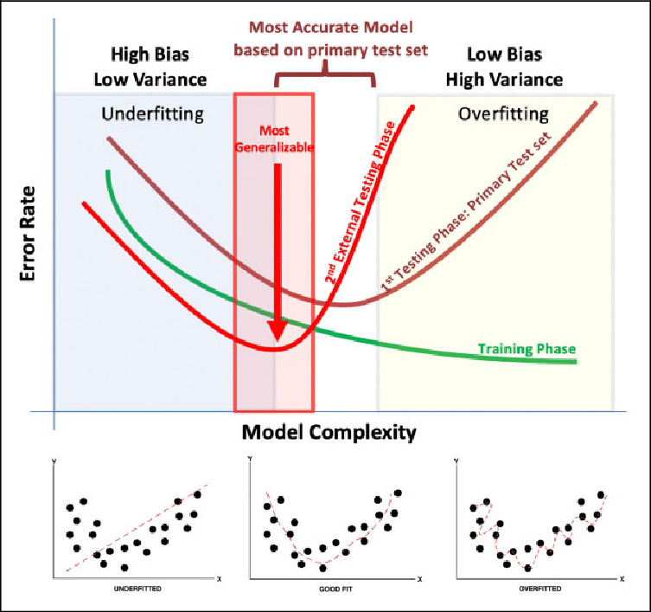
Graphical representation of Bias and variance

Slide 7
Bias and Variance Tradeoff
It suggests that there is a balance to struck between bias and variance. as you decrease bias( by increasing model complexity), typically increase variance . And vice verse.
The goal is to find the righ tlevel of model complexity that minimizes the combined error dut to bias and variance.
Several strategies:-
High Bias (Underfitting): If your model is too simple and has high bias, comsider increasing its complexity. Example :- converting the simple linear regression into polynoimal linear regression
High Variance (Overfitting): If your model is too complex and has high variance, considet simplifying it. Like reduce the number of features, use feature engineering or apply regularization techinques (L1 and L2)

Slide 8
Regularization
Introduce reglarization techinques to penalize overly complex models.
Those are
L1 regularization (Lasso regression)
L2 regularization (Ridge regression)
Elastic Net regularization
Mean squared error = 1/n ∑ (y – ȳ) ²
= 1/n ∑ (y – (wx + b)) ²
= 1/n ∑ (y – (w1x1+w2x2+w3x3+b)) ²

Slide 9
L1 Regularization (Lasso regression)
It is proportional to the sum of the absoulte values of the model coefficients
L1 regularization = λ ∑ | wₓ|
where as, λ= regularization parameter that controls the strength of the regularization
wₓ = Model coefficients
Add this to the cost function
This can help us to reduce the overfitting in the model as well as the feature selection

Slide 10
L2 Regularization (Ridge regression)
It is proportional to the sum of the squared values of the model coefficients
L2 regularization = λ ∑ wₓ²
L1 regularization encourages sparsity and feature selection
L2 regularization enables smallar but non-zero coefficients
This can help us to reduce the overfitting in the model, It includes all the feature present in the model. It reduces the complexity of the model by shrinking the coefficients

Slide 11
Elastic Net regularization
It is the combination of both L1 and L2 regularization and includes both penalty terms in the cost function
Elastic Net regularization = λ₁ ∑ | wₓ| + λ₂ ∑ wₓ²
here , λ₁ and λ₂ controls the strengths of L1 and L2 regularization respectively

